Slide 1



Frenetic Race Against Bureaucracy
Pablo Calleja
Julia Bosque
Ontology Engineering Group
Universidad Politécnica de Madrid, Spain
pcalleja@fi.upm.es
@SPabloCalleja
20/2/2020
Notes:
Cambiar la licencia por la que aplique.

Slide 2
Why?

Slide 3
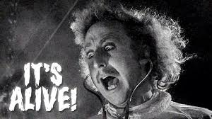
Definitive guideline?
Is this the definitive guideline for the bureaucracy?
NO… BECAUSE…

Slide 4
Main Links
Doctorado DIA
http://www.dia.fi.upm.es/doctoradoia/?q=es/node/222
Normativa
https://www.upm.es/Estudiantes/Estudios_Titulaciones/Estudios_Doctorado/normativa
Politécnica Virtual (PV)
https://www.upm.es/politecnica_virtual/login.upm
Impresos UPM (UPM Prints)
https://www.upm.es/Estudiantes/Estudios_Titulaciones/Estudios_Doctorado/Tesis/Impresos
Teseo
Spanish Database for PhD thesis
https://www.educacion.gob.es/teseo/irGestionarConsulta.do

Slide 5
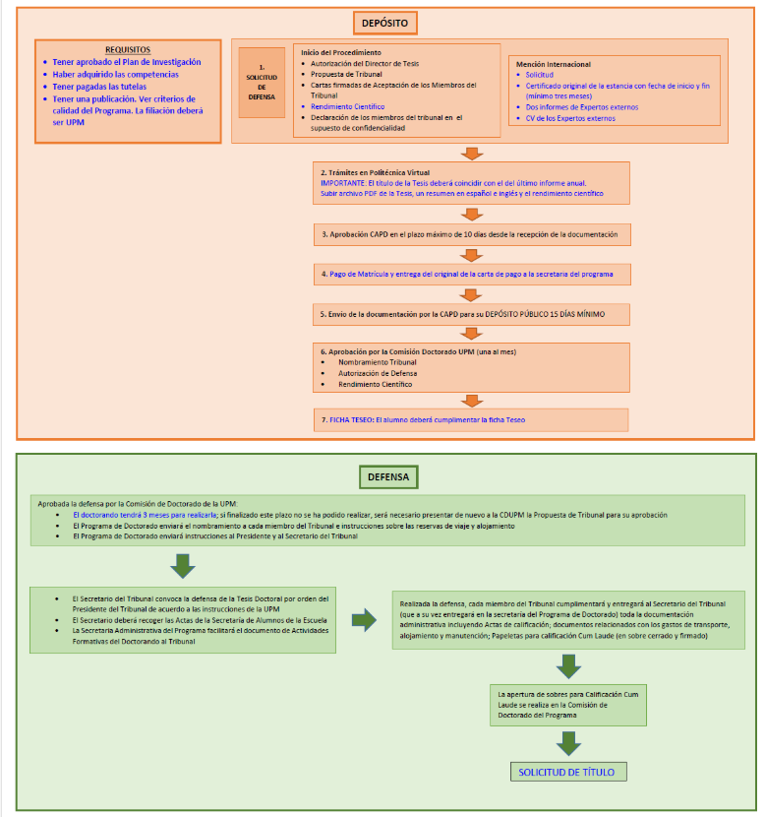
The big picture
From: Doctorado DIA

Slide 6
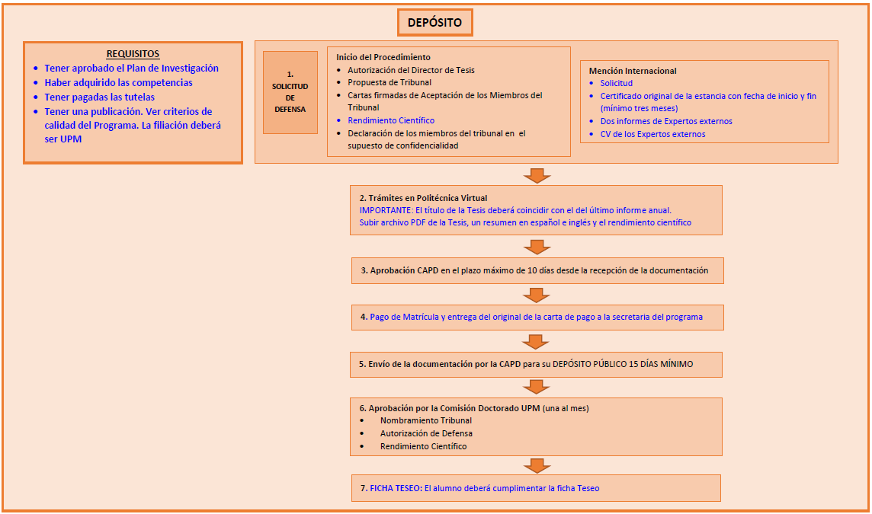
Requirements
Accepted annual research plan (PV - RAPI)
Formation activities
Victoria should have this information
Use the annual report of the activities
Course payment
Quality program:
A Journal
In computer science: Core A
https://www.upm.es/sfs/Rectorado/Vicerrectorado%20de%20Investigacion/Doctorado/Normativa/Documentos/Criterios_calidad_Tesis_Doctorales.pdf

Slide 7
Documents for Deposit
Documents
Director(s) authorization
Examination panel proposal
Acceptance letters of panel members
Original: Signed in blue
Confidentiality clauses (if needed)
Rendimiento Científico:
PV -> Tesis Doctorales -> Curriculum -> acceder a aplicación de CV -> exportar en Excel (solo investigación)
Must contain the Q of the journal or the core of the paper that subscribes the quality program
International Mention
Application form
Original certificate of the internship
3 months
2 reports from external experts
No restrictions to choose
Curriculum of external experts
2nd external panel member payment
http://www.upm.es/Estudiantes/Estudios_Titulaciones/Estudios_Doctorado/Tesis/mencion
Forms: In UPM Prints and WIKI OEG

Slide 8
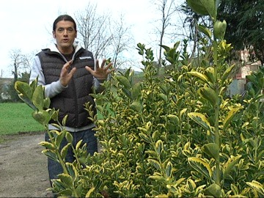
Briconsejo
Create a TXT file with all the important data of your thesis (names, emails, directions, etc.)
Have available documents of:
Change of title
Year extensions

Slide 9
Deposit
Problems:
Time
Commissions
Your own time restrictions (check PV)
From: PV
To: CAPD – Comisión Académica del Programa de Doctorado
Time: Maximum 10 days
True Deposit
From: Payment (Deposit)
To: CDU – Comisión Doctorado UPM
Time: Minimum 15 days

Slide 10
Diagram
Doctorando
CAPD
CDU
Documentation in PV & notification to DIA secretary
Maximum 10 days
- Rendimiento científico approval
- Examination panel approval
- Thesis authorization
Immediate
Thesis Payment
Minimum 15 days
- Thesis examination panel appointment
- Thesis authorization
Pablo Use Case: Deposit Limit 30 September 2019
20 September
26 September
26 September
15 October
Last CDU
Julia Use Case: Deposit Limit 15 September 2019
4 September
11 September
11 September
15 October
Last CDU

Slide 11
Deposit. Next steps
Teseo:
Essential Information about your thesis
Keywords
Directors
Tribunal: Affiliation, DNI, Passport, …
Follow the tutorial in UPM Prints
Can be completed after the defense

Slide 12
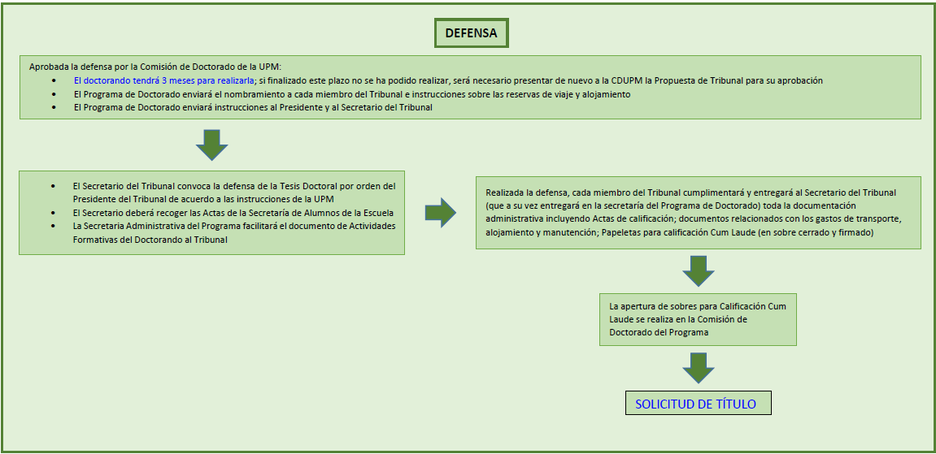
Defense

Slide 13
Title Application
Requirements
CAPD – Cum Laude
DIA Secretary informs FI Secretary
Documents:
Thesis Payment documents (4 – 2 for the University)
Library certificate
Application form (2)
Scanned DNI (2)

Slide 14
Conclusions
Think and check your time restrictions for thesis deposit
Start collecting your important documents
Be patient
Careful with your own grants. Other documents may be needed
Special thanks to:
Emilio Serrano

Slide 15

Good Luck!

Slide 16
Frenetic Race Against Bureaucracy
Pablo Calleja
Julia Bosque
Ontology Engineering Group
Universidad Politécnica de Madrid, Spain
pcalleja@fi.upm.es
@SPabloCalleja
20/2/2020
Notes:
Cambiar la licencia por la que aplique.

